Slide 1
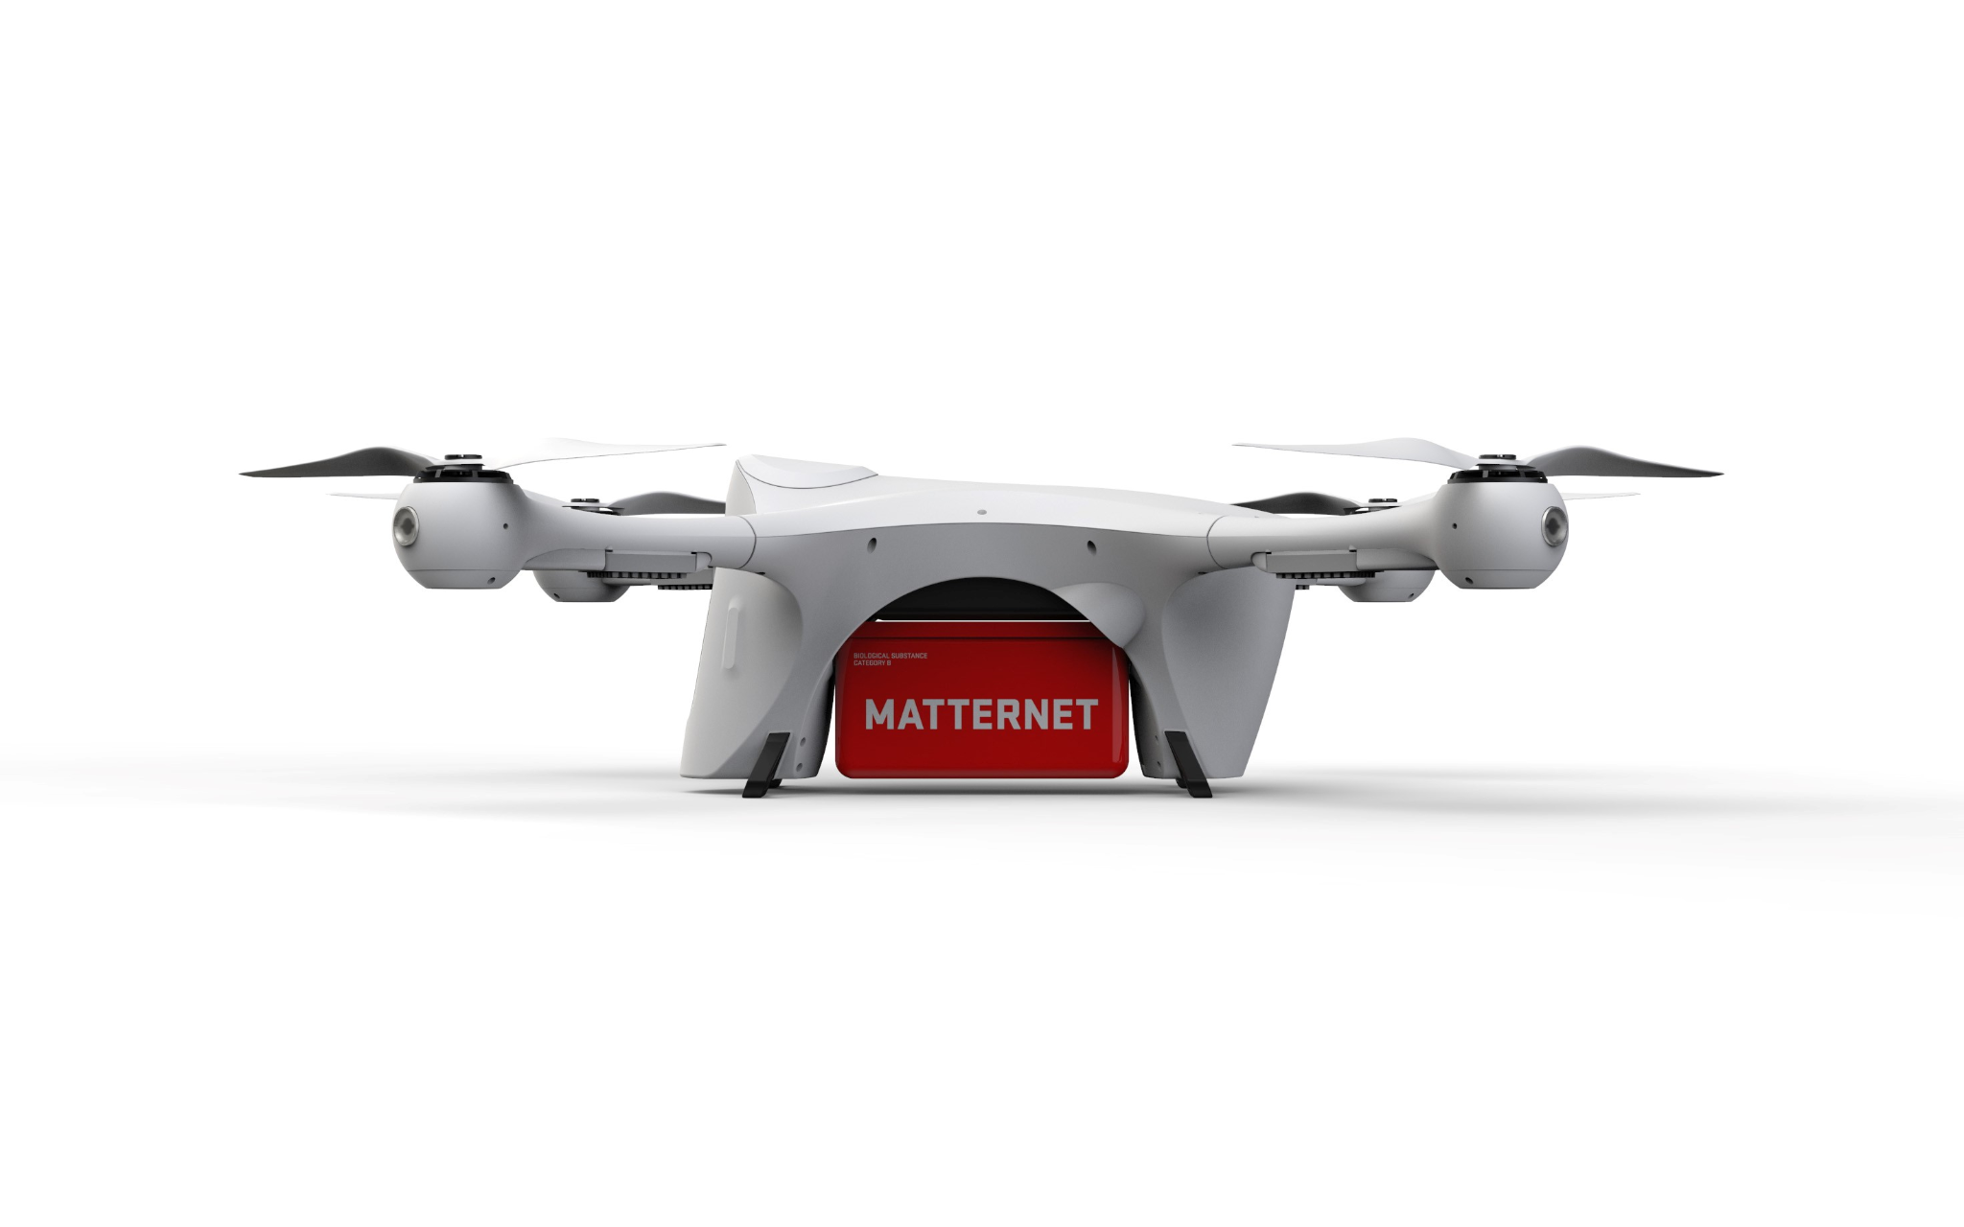

“PATH PLANNING FOR DRONES FLYING BEYOND VISUAL LINE OF SIGHT”
Presented by : MD Aman Hussain 160921733151

Slide 2
Index
01 :Introduction
:Applications
: BVLOS Flights' Performed Operations
:BVLoS Advantages & Challenges
02 :Risk Analysis
03 :Related Work
:Risk map
:Components of a Risk Map
04 :My Work
05 :Result And Analysis
06 :Conclusions
07 :Future Work
08 :References
:

Slide 3
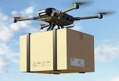
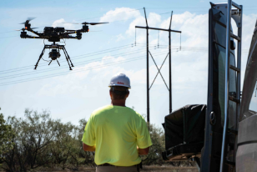

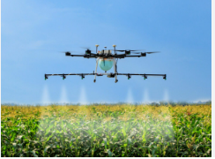
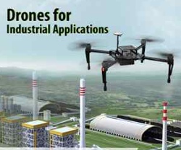
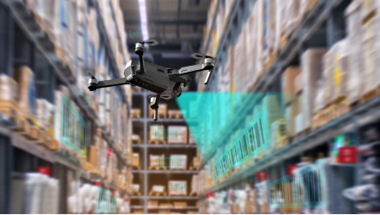
Introduction:
A drone is an unmanned aerial vehicle (UAV) that is controlled remotely or autonomously through onboard computers.
Applications
Provide Services for Delivery
Inspection of Critical Infrastructure
Agriculture Large-Scale Crop Monitoring
Industrial Applications
Environmental Monitoring
Logistics and Supply Chain Inventory
Management

Slide 4
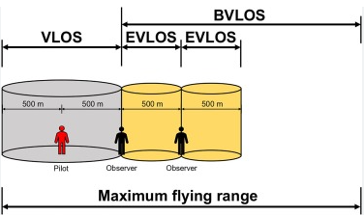
Types of Drone Operations
VLoS (Visual Line of Sight): Drone stays within the pilot's direct view, typically up to 500 meters.
EVLoS (Extended Visual Line of Sight): Trained observers help fly the drone beyond the pilot’s direct view, usually up to 15 km, with special permissions.
BVLoS (Beyond Visual Line of Sight): Drone operates beyond the pilot’s sight using advanced tech, enabling long-distance flights but requiring strict regulatory compliance.
Figure 1: Range of VLOS, EVLOS and BVLOS Flights

Slide 5
BVLoS Advantages & Challenges
Advantages:
1.Increased Operational Range
2.Greater Efficiency
3.Decreased Human Intervention
4.Improved Data Collection
5.Cost-effective
Challenges:
1.Regulatory Restrictions
2.Infrastructure and technology
3.Risk and Safety coordination
4.Difficulties Operation
5.Processing and Analysis of Data

Slide 6
Risk Analysis
1.Collision Risks
2.Communication Failures
3.Navigation Issues
4.Environmental Factors
5.Ground Impact Risks

Slide 7
Related Work
Techniques:
1.Geographic Information Systems (GIS)[16]
This paper leverages GIS data to assess collision risks by mapping out obstacles like buildings, power lines, and trees.
2.Path Planning Algorithms[16]
The authors implement path planning algorithms that factor in obstacle avoidance and optimize flight paths to minimize risk.
3.Heat Maps[16]
4.Risk-Aware Path Planning[10]
5.Dynamic Obstacle Management[10]

Slide 8
Risk map
0,0 |  |  |  | 0,M
N,0 |  |  |  | M,N
3D location-based map corresponding to a geographic region
Quantifies risk to individuals on the ground for each cell(small square) in the map
Risk map center

Slide 9
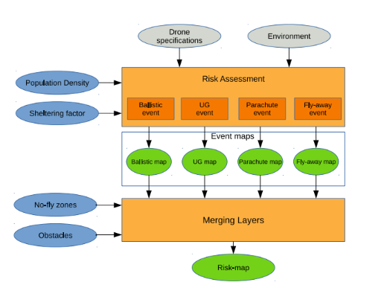
Layers of a Risk Map
Population Density layer
Obstacle layer
Sheltering layer
No-fly zone

Slide 10
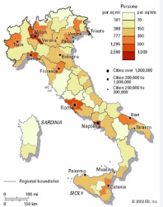
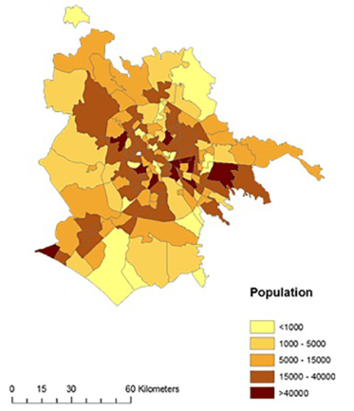
Population Density layer
Purpose: Determines population density to assess risk.
Impact: Higher population density increases risk values.
Resolution: 1 km² global grid; 100 × 100 m for detailed maps.
Example: Population density is measured in Urban Areas(Rome)
Population Density=total population/area,
( Rome total population=28.7lakhs,total areas=1285 km^2)
Population density=2870000/1285
=2232 people/km^2
[Sub-urban(Italy,Modena) 978.9people/km^2
Rural(Italy,
Figure 4: population density Italy(Rome)
Figure 3: population density Italy

Slide 11
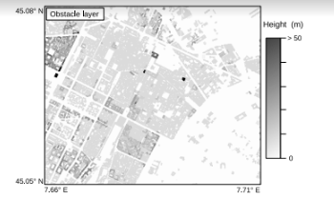
Obstacle Layer
Defines height of obstacles (e.g. buildings, trees, towers)
Figure 5: On top the obstacle layer of Turin city center with a resolution of 10 × 10 m.

Slide 12
Sheltering Factor Layer
Table 2:Sheltering factor classification [8,16]
Definition: Sheltering factor is a real number (0–10) quantifying the likelihood of fatal injuries in a crash.
Range: 0 = no shelter; 10 = maximum shelter (e.g., industrial building).
Example: Sheltering factor 2 with 250 J kinetic energy gives a 0.38 fatality probability; at factor 10, it drops to 0.025.
Sheltering | Area
0 | No obstacles
2.5 | Sparse trees
5 | Vehicles and low buildings
7.5 | High buildings
10 | Industrial building

Slide 13
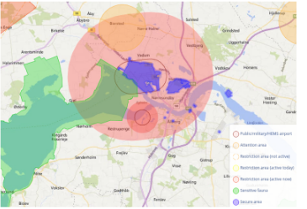
No-Fly Zone Layer
Each element can assume two values:
0 where the flight is allowed
−1 where the flight is forbidden (Example:- Aalborg,Denmark,
Venice from Mestre(closest town))
.
Figure 4: Example of no-fly zones around the city of Aalborg, Denmark.

Slide 14
My Work
1.Risk Identification
I identified potential ground risks, such as collisions with obstacles like buildings, trees, and other structures, and assessed the risks to people and property in case of drone failures.
2.Data Collection
I gathered geospatial data, including maps of the region, detailed obstacle information, and population density data, to understand the environment in which the drones would operate.
3.Obstacle Height Quantification
I specifically quantified the heights of various obstacles within the flight area.Large areas, including urban, suburban, and rural settings, can have their risk measured by the risk map, which also makes it simple to determine which parts of the flight are high- and low-risk
4.Risk Assessment Models

Slide 15
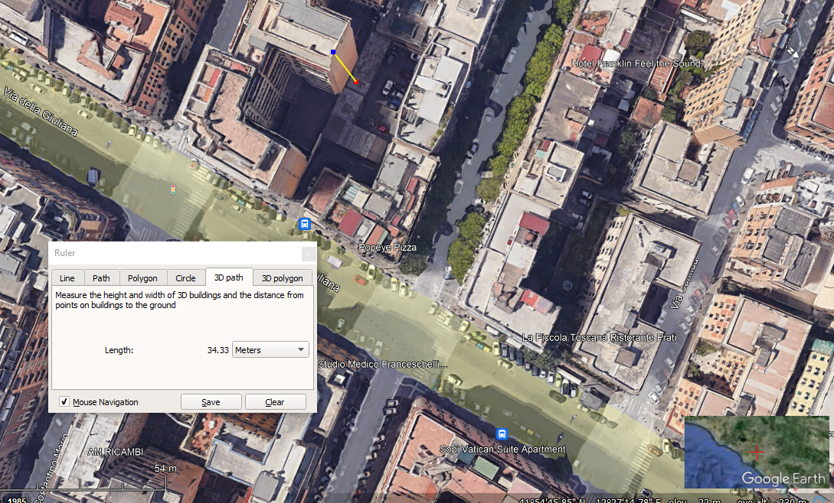
Obstacle Layer
Defines height of obstacles (e.g. buildings, trees, towers)
In this figure, the obstacle layer is defined using the model of the city of Rome from Google Earth Pro map
Obstacle Height
Figure 5: obstacle height

Slide 16
Implementation
.
Regions | Range of Sheltering factor | Range of Obstacle heights (m) | Mass of UAV (kg) | Altitude at which UAV will fly (m) | Initial Velocity of the UAV (m/s)
Urban | 0 - 7.5 | 0-51 | 3.75 | 120, 60, 40 | 19.4444
Sub Urban | 0 - 7.5 | 0-42 | 3.75 | 120, 60, 40 | 19.4444
Rural | 0 – 5 | 0-16 | 3.75 | 120, 60, 40 | 19.4444
The implementation creates a Java executable for generating risk maps in Visual Studio Code, using the "Grid Map" Java package to manage 3D grid maps with multiple data layers.
Table 3:The values used to determine the risk value during program implementation are displayed in the table

Slide 17
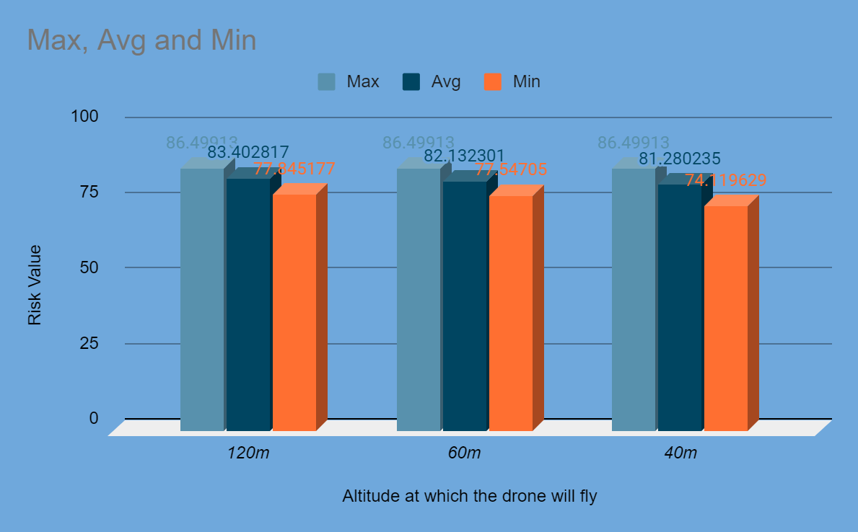
Result And Analysis
Ultimately, the maximum, average, and minimum risk for each of the three zones are determined from all the data, and a graphical analysis is performed on them, the results of which are provided below.
1.Urban Region Graphical Analysis:
Risk Value vs. Altitudes Analysis (Urban Region)
Urban Area | 120m | 60m | 40m
Max | 86.499130 | 86.499130 | 86.499130
Avg | 83.402817 | 82.132301 | 81.280235
Min | 77.845177 | 75.547050 | 74.119629
Table showing the highest, average, and lowest values from the urban region's risk map
Figure 6: Graphical Analysis of maximum, average and minimum risk value for urban regions.

Slide 18
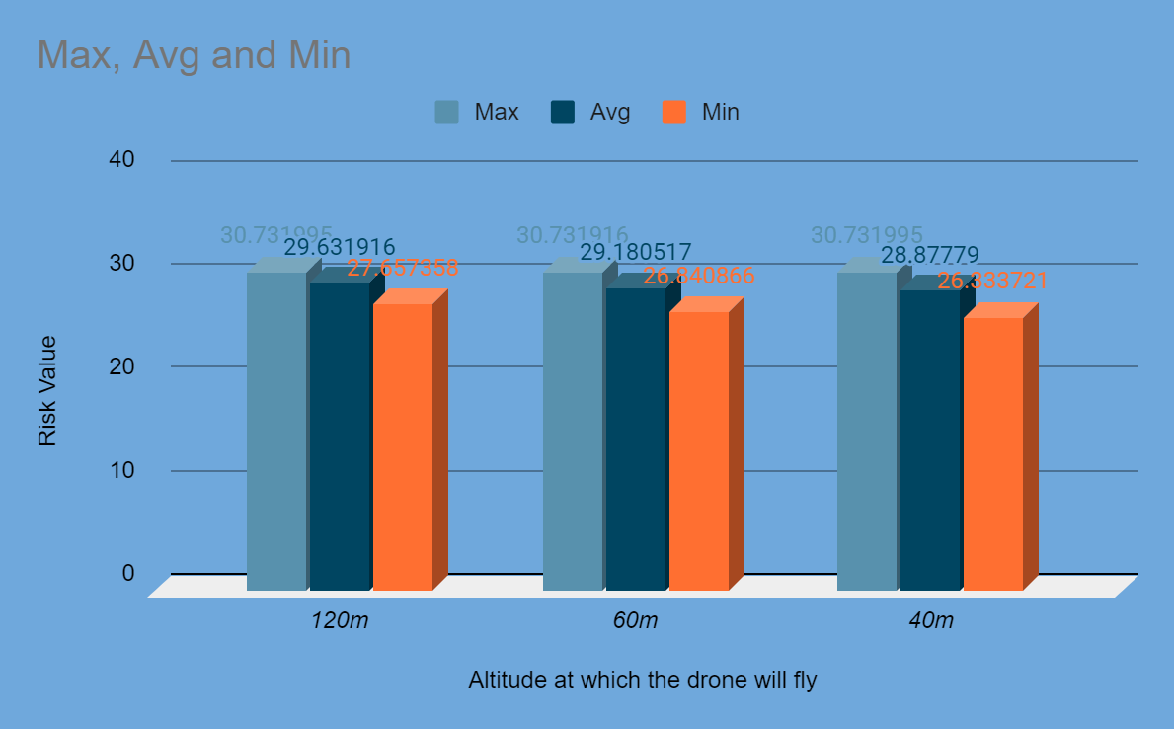
2.Sub-Urban Region Graphical Analysis
Risk Value vs. Altitudes Analysis (Sub-Urban Region)
Sub-Urban Area | 120m | 60m | 40m
Max | 30.731995 | 30.731916 | 30.731995
Avg | 29.631916 | 29.180517 | 28.877790
Min | 27.657358 | 26.840866 | 26.333721
Figure 8: Graphical Analysis of maximum, average and minimum risk value for Sub-urban region (Italy, Rome).
Table showing the highest, average, and lowest values from the urban region's risk map

Slide 19
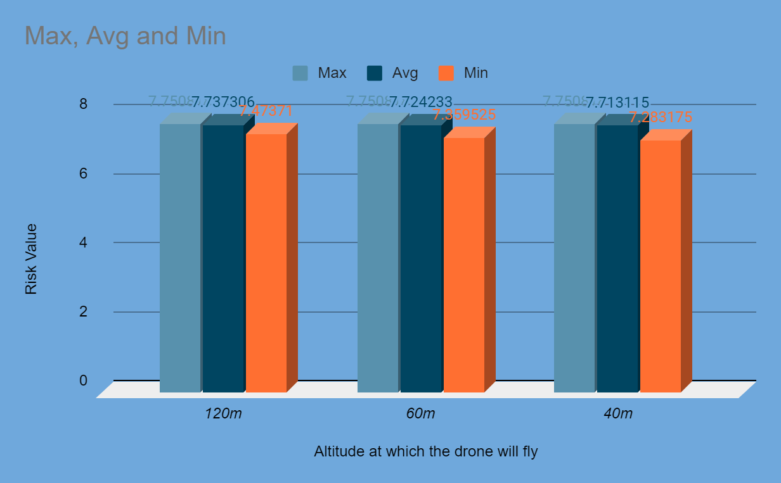
3.Rural Region Graphical Analysis
Risk Value vs. Altitudes Analysis (Rural Region)
Rural Area | 120m | 60m | 40m
Max | 7.750818 | 7.750818 | 7.750818
Avg | 7.737306 | 7.724233 | 7.713115
Min | 7.47371 | 7.359525 | 7.283175
.
Table showing the highest, average, and lowest values from the Rural region's risk map.
Figure 15: Graphical Analysis of maximum, average and minimum risk value for Rural region.

Slide 20
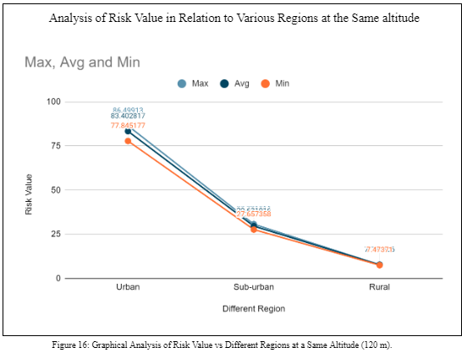
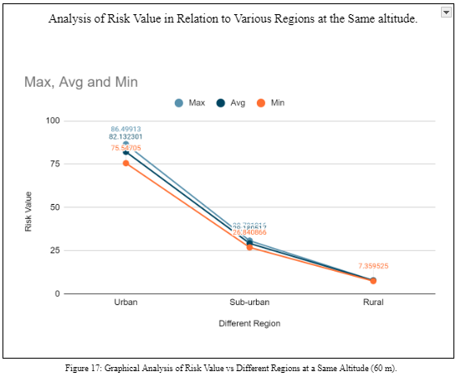
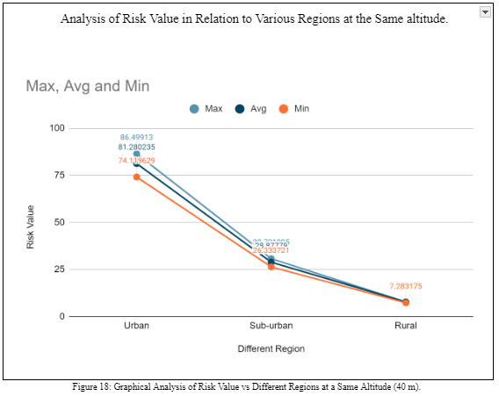
Visual analysis of various locations at the same altitude:
At altitude=120m At altitude=60m At altitude=40m

Slide 21
Conclusions
Objective: Developed a ground risk map for unmanned aircraft systems (UAS) applicable to urban, suburban, and rural environments.
Methodology: Used a probabilistic risk assessment approach to calculate risk values by considering:
Environmental factors
Drone specifications
Uncertainties related to parameters and obstacle heights
Descent Scenarios: Included various descent scenarios in the analysis:
Flyaway
Parachute drop
Uncontrolled glide
Ballistic fall
Risk Map Components: Integrated multiple layers into the risk map:
Population density
Sheltering data
No-fly zones
Obstacles
Simulation Results: Demonstrated the effectiveness of the risk map in:
Quantifying risk
Identifying the least risky path for UAS missions
Utility: The risk map serves as a tool for risk-informed decision-making, aiding in the safety assessment of drone operations across various environments.

Slide 22
Future Work
Extra Aircraft Types: Make plans to incorporate additional aircraft types into the risk analysis.
More Descent situations: Make an effort to include more situations of descent in the study.
Enhanced Accuracy: Aim to improve probability computation accuracy to improve risk assessments.
Midair Collision Risks: For a more complete safety analysis, consider extending the risk map to include midair collision risks.
Enhanced Utility: With these modifications, the risk map will be even more helpful for organising and carrying out safe and knowledgeable drone flights.

Slide 23
References:
[1] F. Mohammed, A. Idries, N. Mohamed, J. Al-Jaroodi, I. Jawhar, Uavs for smart cities: Opportunities and challenges, in: ICUAS 2014, International Conference on Unmanned Aircraft Systems, 2014, IEEE, 2014, pp. 267–273.doi:10.1109/ICUAS.2014.6842265.
[2] European Aviation Safety Agency, Notice of proposed amendment 2017-05 (a) introduction of a regulatory framework for the operation of drones, Tech. rep. (2017).
[3] European Aviation Safety Agency, Notice of proposed amendment 2017-05 (b) - introduction of a regulatory framework for the operation of drones, Tech. rep. (2017).
[4] E. Capello, M. Dentis, L. N. Mascarello, S. Primatesta, Regulation analysis and new concept for a cloud-based uav supervision system in urban environment, in: RED-UAS 2017, Workshop on Research, Education and Development of Unmanned Aerial Systems, IEEE, 2017, pp. 90–95. doi:10.1109/RED-UAS.2017.8101649.
[5] FAA, Federal Aviation Administration, UAS Integration Pilot Program, https://www.faa.gov/uas/programs_partnerships/uas_ integration_pilot_program/, accessed: 2018-06-26.
[6] FAA, Federal Aviation Administration, System safety handbook, Department of transportation, Washington DC, USA, 2000
[7] FAA, Federal Aviation Administration, System safety handbook, Department of transportation, Washington DC, USA, 2000.
[8] EASA, Certification specifications and acceptable means of compliance for large aeroplanes cs-25, Tech. rep., Amendment 21, European Aviation Safety Agency (2018).
[9] R. A. Clothier, R. A. Walker, Safety risk management of unmanned aircraft sys59tems, in: Handbook of Unmanned Aerial Vehicles, Springer, 2015, pp.2229–2275.
[10]T. Goerzen, Z. Kong, B. Mettler "Risk-Aware Path Planning for BVLOS Drone Flights in Urban Areas" Autonomous Robots, 2018.
[12] E. Denney, G. Pai, I. Whiteside, Modeling the safety architecture of uas flight operations, in: International Conference on Computer Safety, Reliability, and Security, Springer, 2017, pp. 162–178. doi:10.1007/978-3319-66266-4_11.
[13] X. Lin, N. L. Fulton, M. E. Horn, Quantification of high level safety criteria
[14] E. Ancel, F. M. Capristan, J. V. Foster, R. C. Condotta, Real-time risk assessment framework for unmanned aircraft system (uas) traffic management(utm), in: 17th AIAA Aviation Technology, Integration, and Operations Conference, 2017, p. 3273.
[15] R. A. Clothier, R. A. Walker, N. Fulton, D. A. Campbell, A casualty risk analysis for unmanned aerial system (uas) operations over inhabited areas,in: AIAC12, Twelfth Australian International Aerospace Congress, 2nd Australasian Unmanned Air Vehicles Conference, 2007, pp. 1–15.
[16]S. Patel, L. Nguyen, K. Wong "Aerial Collision Risk Assessment for BVLOS Drone Operations Using GIS Data" International Journal of Remote Sensing, 2018.

Slide 24
THANK YOU

